Slide 1
Evaluating ChatGPT as a Recommendation System
Peyman Naseri
NLP project presentation
Fall 02-03

Slide 2
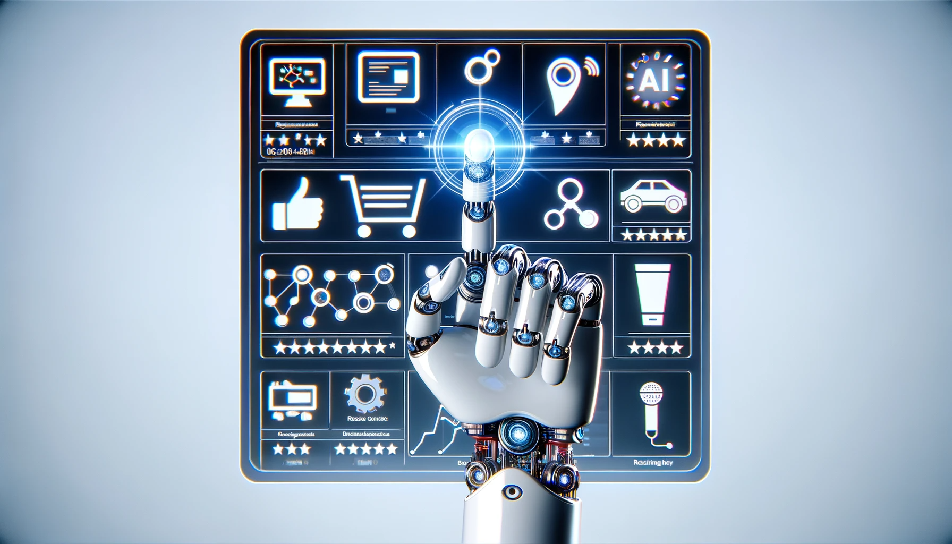
Notes:
Topic Context: Understanding the role of AI in recommendation systems.
Project Focus: ChatGPT's potential as a recommender.
Significance: Impact on personalized user experiences and AI technology evolution.
Study Inspiration: "Is ChatGPT a Good Recommender? A Preliminary Study".

